Slide 1
Science Journalism with UANews
Emily Walla
Mentor: Daniel Stolte, University Communications
Arizona Space Grant Symposium
Hosted by the University of Arizona
April 14, 2018

Slide 2
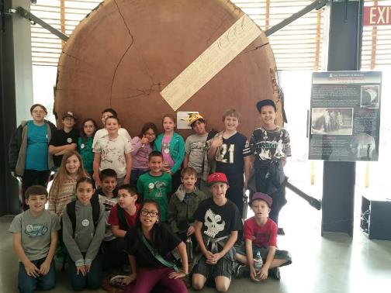
Had I ever done science writing before this internship?
No
Notes:
The first Question Daniel asked me when I started.
I’d never done science writing but I had done science communication for elementary schools

Slide 3
What is Science Writing?
Translating science into language anyone can understand
“Mechanistically, mutant TDP-43 sequesters hsc70-4 mRNA and impairs its translation. Expression of the Hsc70-4 ortholog, HSPA8 is also reduced in primary motor neurons and neuro-muscular junction of mice”
From Coyne, et al (2017)
The mutated protein TDP-43 traps the RNA that codes for another protein – hsc70-4 – and keeps the protein from being produced. With abnormally high amounts of TDP-43, mice produced less HSPA8, mammals’ version of fruit flies’ hsc70-4.

Slide 4
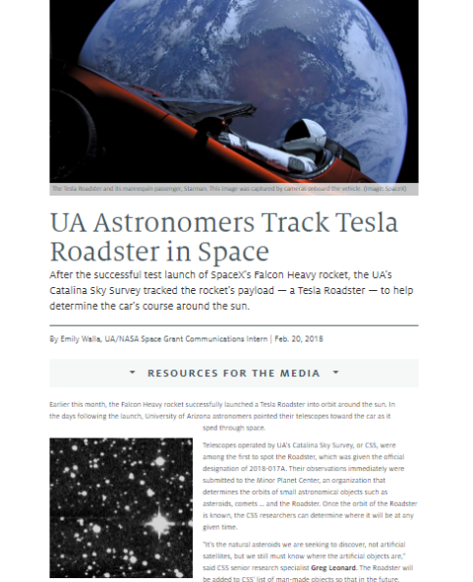
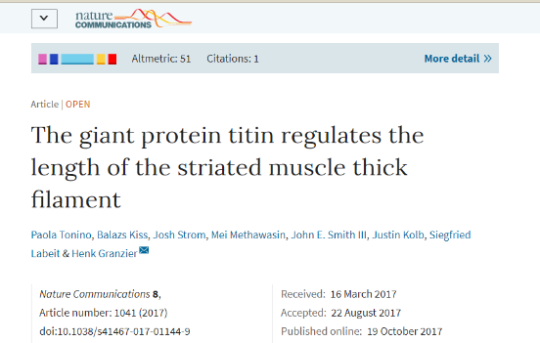
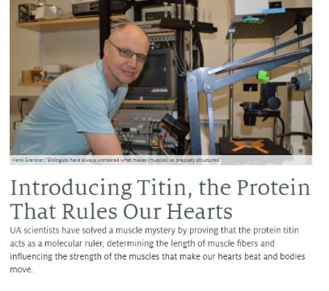
Finding Stories
Researchers and Publications
Current Events

Slide 5
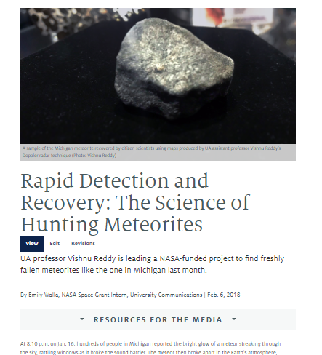
The Writing Process
Step 1: Do your Research!
Step 2: Conduct an Interview
Step 3: Write a Draft
Step 4: Review
Step 5: Publish

Slide 6
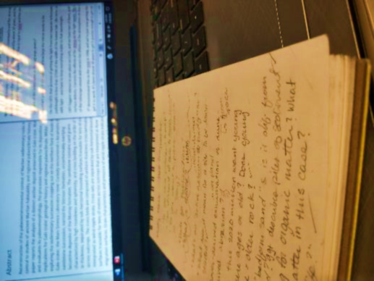
The Interview
Come Prepared
Play Dumb
Take Notes
Transcribe the Interview
Not pictured: the 36 browser tabs I am using for research
Notes:
***You have a pic on your phone for this slide***
Come prepared with a list of questions to begin with. Usually I open with, “So, tell me what this research is about,” or “What did you do in the research?”
Play Dumb – even if you can explain a concept flawlessly, ask the researcher about it anyway. That way, you can get some nice quotes and you might learn something.
Take Notes: Taking notes is more important than listening to the scientist. Take Notes and Record, just in case something goes wrong and you lose one of those two things.
Transcribe the interview as soon as you can afterwards. This helps you write the transcription faster and ensures that you have all your material prepared before you begin the draft.

Slide 7
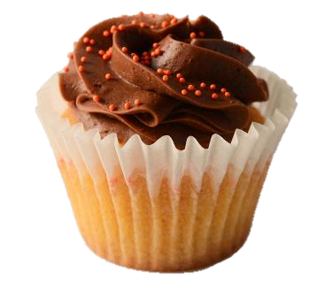
The Draft Outline
Who, What, When and Where, and Why is it Newsworthy?
Supportive Quote and Important Details
More Info
Notes:
Cupcake: The Headline and Subheadline/Summary and Lede are like the frosting and sprinkles.

Slide 8
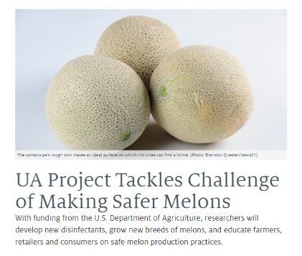
Review and Publish
Have researcher validate the facts and quotes in the story
Read the story one last time
Submit story for publishing
Beware of Embargo dates

Slide 9
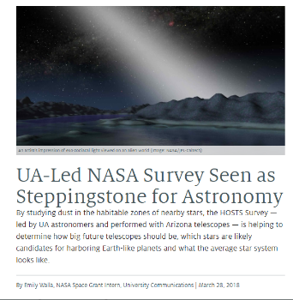
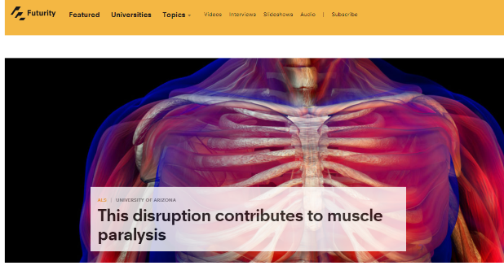
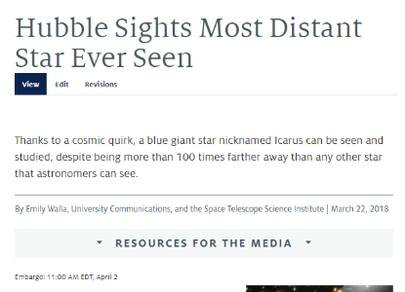
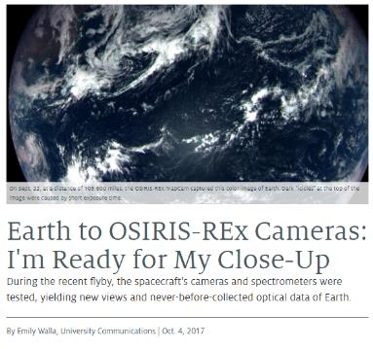
After You Publish
Congratulations!
Now it’s time to start another story!
Stories may be picked up by larger news services
Currently I have 11 stories published on UANews
2 were picked up by Futurity
3 were collaborations with other institutions

Slide 10
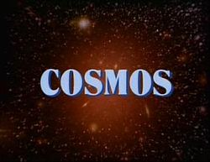
The Value of Science Writing
Draw attention to research
Educate the general public
Inspire others to pursue and support science
Notes:
Find some kind of picture to add here god It looks so bland and blank

Slide 11
Acknowledgements
Special Thanks to Doug Carroll, Alexis Blue, Stacy Pigott and everyone at University Communications
Thank you to the Arizona Space Grant Consortium

Slide 12
Thank You!

